Slide 1
10.4
The Divergence and
Integral Tests

Slide 2


Slide 3
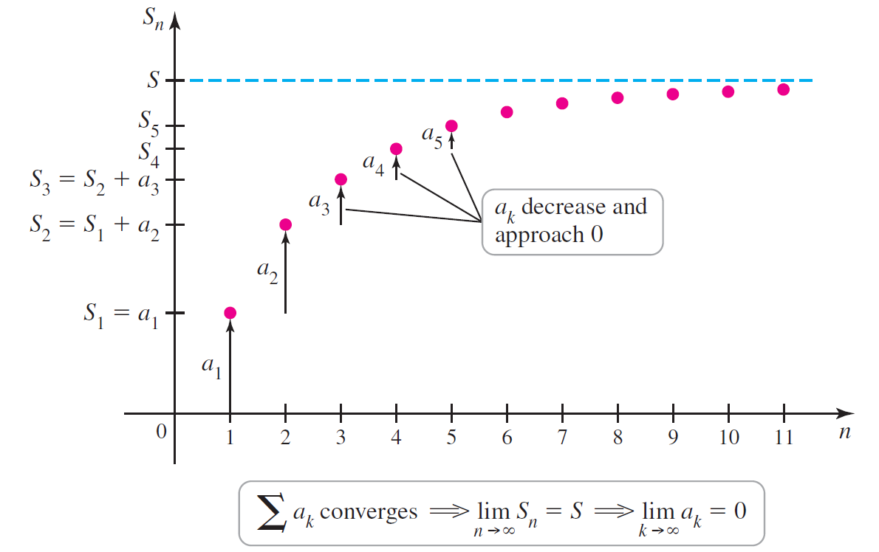
Figure 10.25

Slide 4
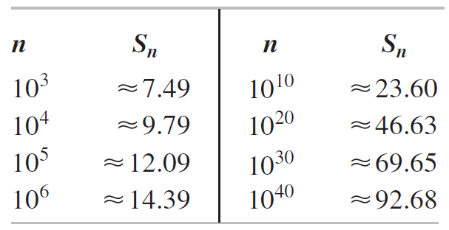
Table 10.3

Slide 5
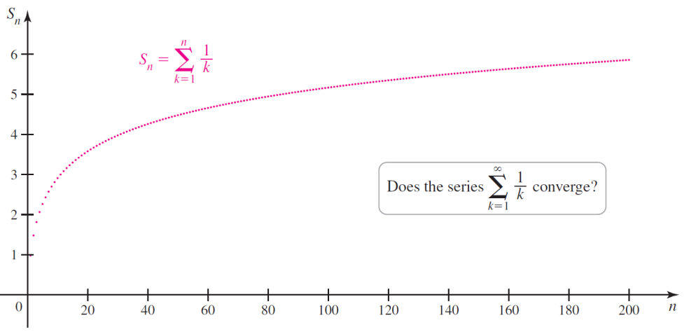
Figure 10.26

Slide 6
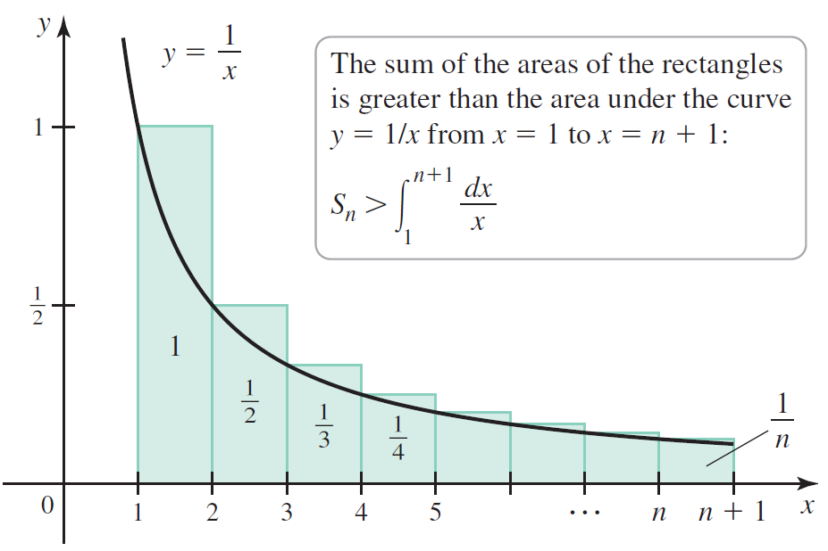
Figure 10.27

Slide 7


Slide 8


Slide 9

Figure 10.28

Slide 10


Slide 11
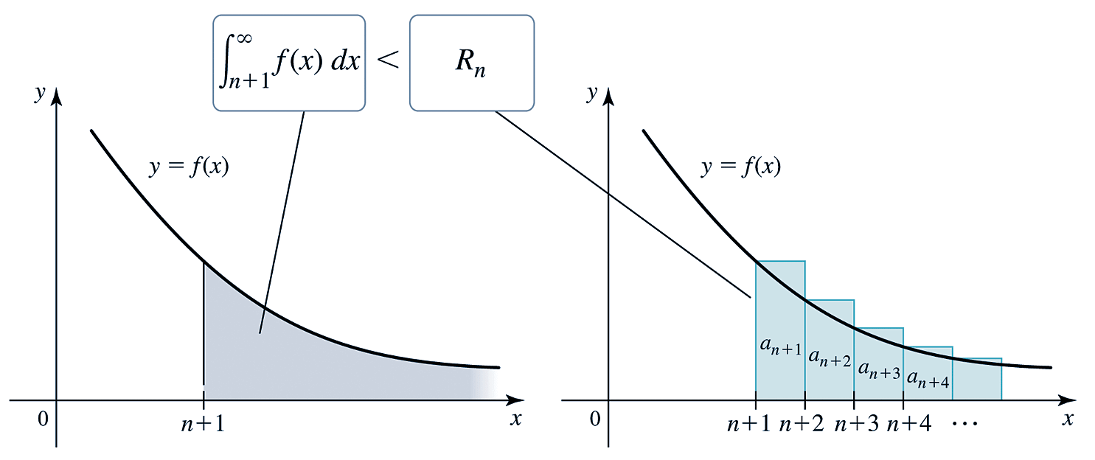
Figure 10.29

Slide 12
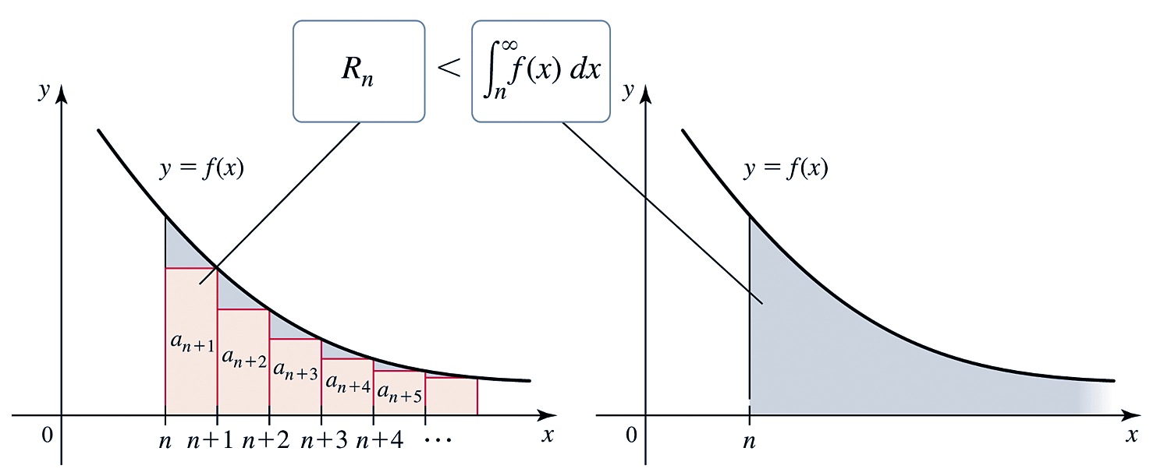
Figure 10.30

Slide 13
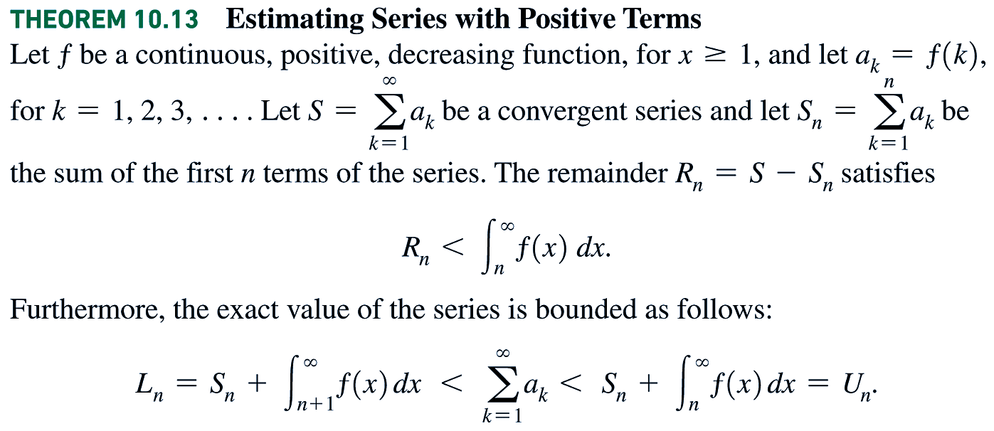

Slide 14
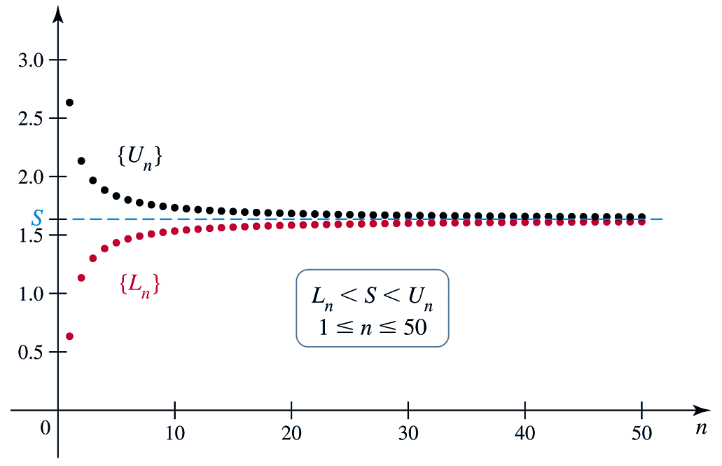
Figure 10.31 (a)

Slide 15
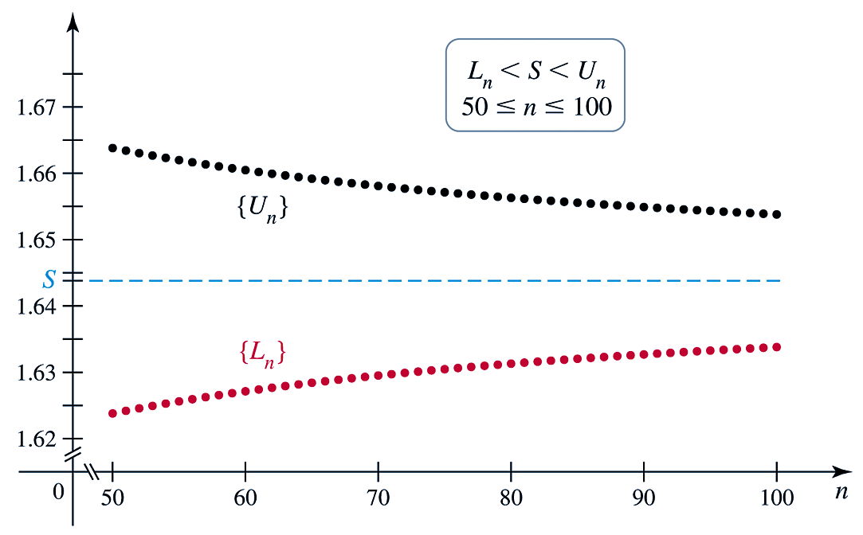
Figure 10.31 (b)

